Slide 1
RGEO: Struggling in Climate Change
in a War zone
Rural Green Environment Organization - Afghanistan

Slide 2
Identification of RGEO
Location
Scale
Mission
Impacts of war
Achievement

Slide 3
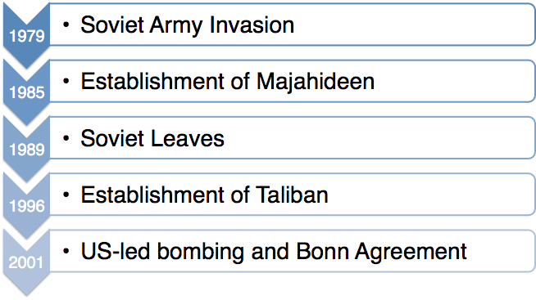
History of War

Slide 4
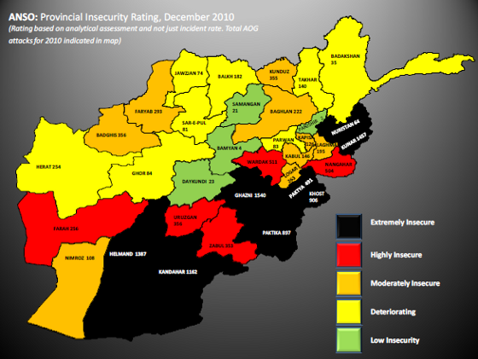
Map of Conflicts

Slide 5
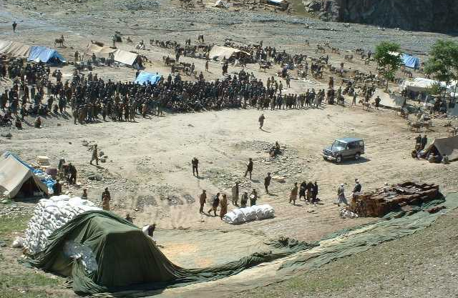
Conflicts and Community

Slide 6
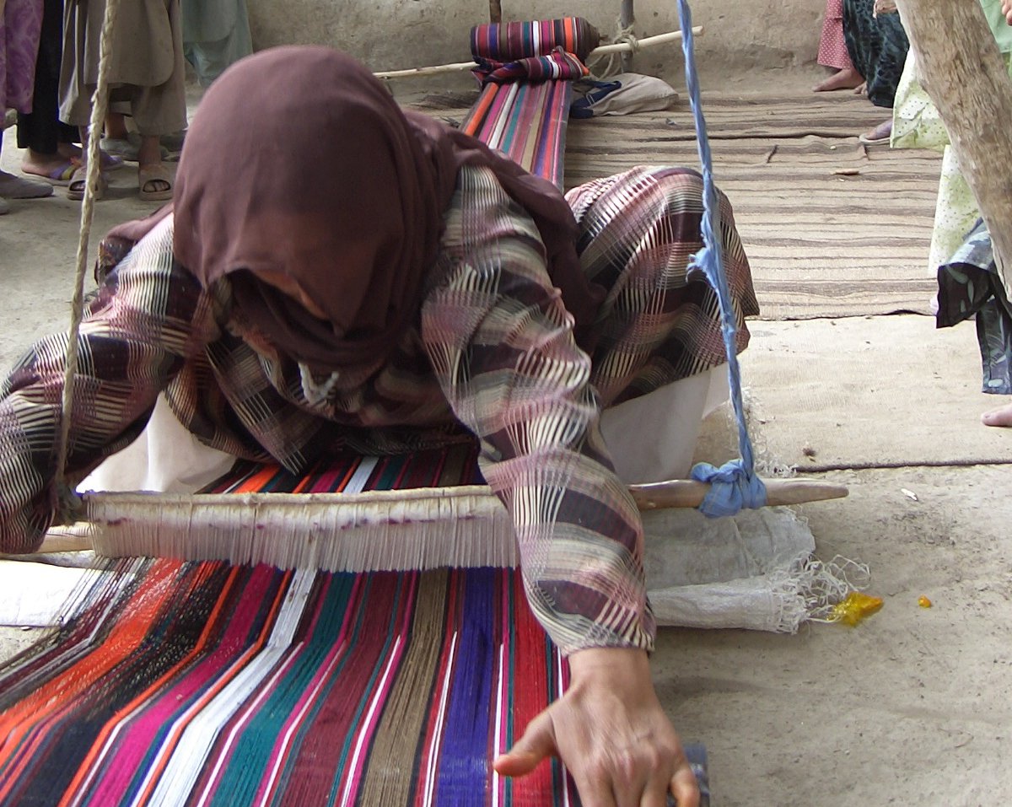
Conflicts and Women

Slide 7
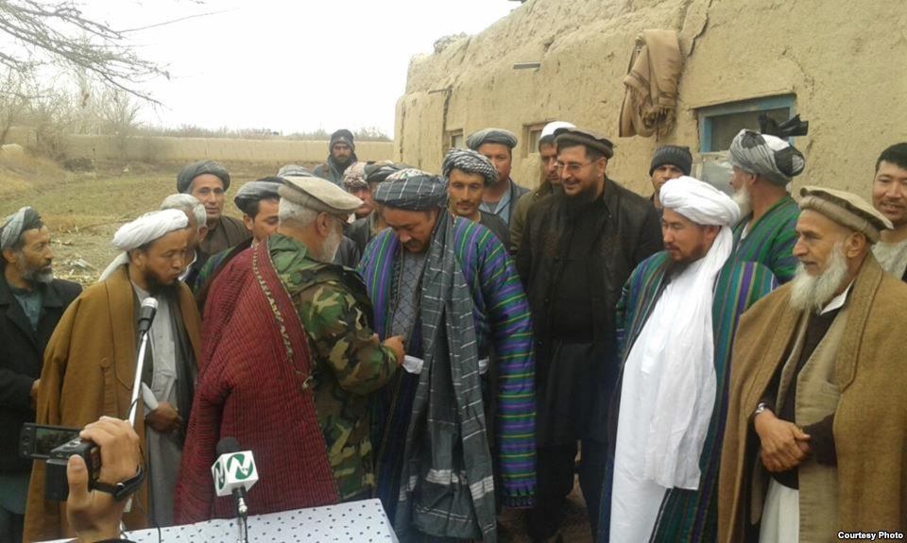
Conflicts and Local Commander

Slide 8
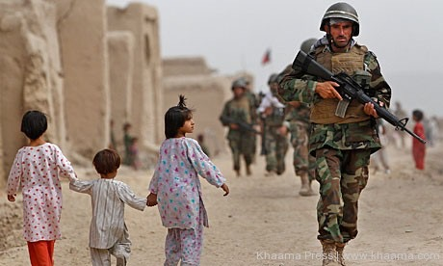
Conflicts and Children

Slide 10
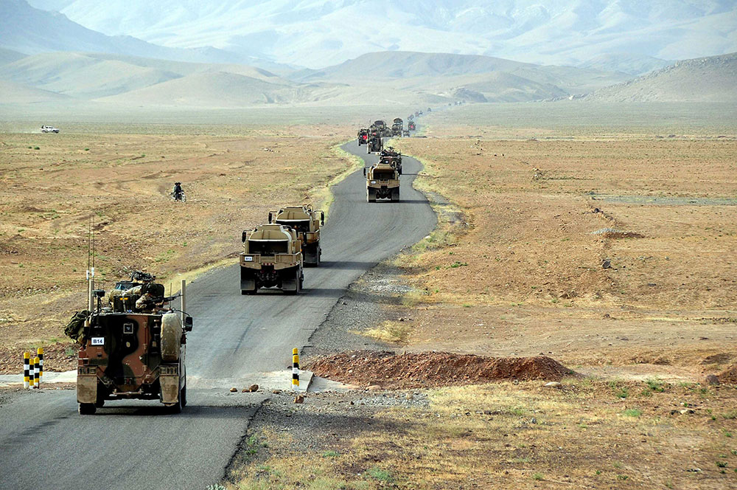
Conflict and Transport

Slide 11
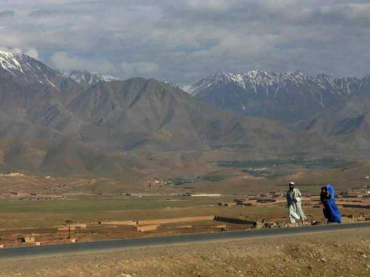
Conflicts and Transport

Slide 12
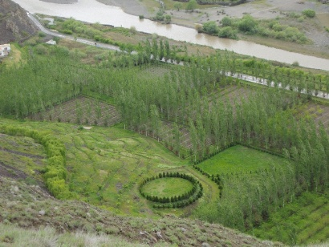
Achievements

Slide 13
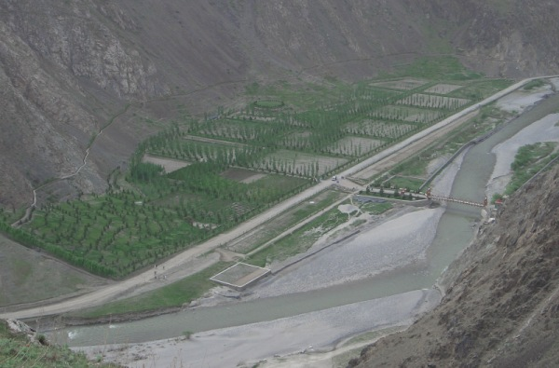
Achievement

